Slide 1
Analysing and Forecasting Future Order Statistics
Luke Calleja – IT-SWD6.2A – Business Intelligence and Reporting

Slide 2
Forecasting Order Statistics
For this research project, it was decided that the forecasting of future number of orders will be done
The aim of this is for the business to be able to see how their order figures are currently performing and where improvements need to be made
There are many benefits to forecasting, such as better stock management and much more information about the client can become available

Slide 3
Why Forecast?
Forecasting can give a great indication of where the business is heading, how it is performing currently and where improvements can be made
The management of the business can be handled better with forecasting.
External factors will always have an effect on businesses. Forecasting can allow one to manage negative impacts on a business.

Slide 4
Previous Studies
There are a number of studies and research papers on this subject
Some reports forecast data based on client information while others base theirs on previous figures.
For this review, two particular papers were focused on, which are:
“Retail Sales Prediction and Item Recommendations Using Customer Demographics at Store Level” by Michael Giering
“An Improved Sales Forecasting Approach by the Integration of Genetic Fuzzy Systems and Data Clustering: Case Study of Printed Circuit Board” by Esmaeil Hadavandi, Hassan Shavandi and Arash Ghanbari

Slide 5
Retail Sales Prediction and Item Recommendations Using Customer Demographics
This study was conducted by gathering data over an 18 month period in a number of different stores
This study catered for 600 different items which can be found across the stores. However, certain items were not found in all the stores
Different customer types were also taken into consideration. These differences included factors such as age and yearly income
The primary objective of this study was to develop a method to recommend products to different clients.
This method would be able to suggest a certain product to a client depending on the types of items they buy

Slide 6
Retail Sales Prediction and Item Recommendations Using Customer Demographics
This type of forecasting can increase sales on the whole
By recommending products to clients, they may be encouraged to buy more than what they initial went in store to buy.
For example, say a customer came in to buy some shampoo. The customer may also buy some conditioner if it is recommended to them. If it is not, the customer will just come in for what they came for and leave without buying anything else.
With this product recommendation method, sales can be increased significantly.

Slide 7
An Improved Sales Forecasting Approach by the Integration of Genetic Fuzzy Systems
This report highlighted the importance of sales forecasting
The method of data clustering was used to be able to create a reliable and accurate sales forecasting system
A fuzzy system was developed to create an expert system for forecasting
This system has been successfully applied to a host of different real world scenarios in different areas
However, despite its accuracy, there a number of tasks which need to be performed which can be very time consuming.

Slide 8
Research methodology
The research methodology used for this project was CRISP-DM
CRISP-DM stands for Cross-Industry Process for Data Mining
The data gathered was from a pre-determined data set of orders from 1998 and 1999
The orders were split according to region and split into the different quarters of the year.

Slide 9
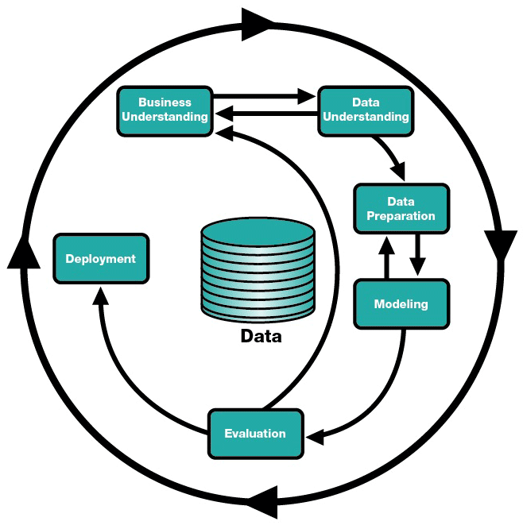
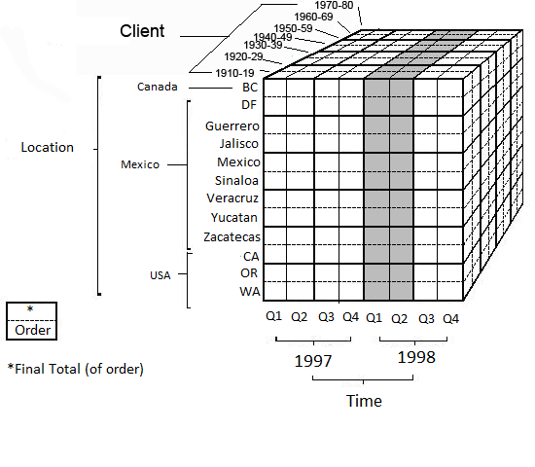
Research Methodology

Slide 10
Findings & Results
The data consisted of a number of orders and clients spread over 12 regions
There was no order data in neither 1997 nor 1998 for regions Mexico and Sinaloa
There was also no order for all of the regions except CA, OR and WA in 1997
This made forecasting slightly less accurate for the other regions

Slide 11
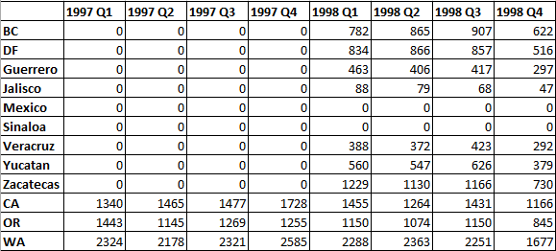
Analysis of Results
The results were recorded in a table
1997 saw a lot of regions which did not have any orders recorded
Of those which did, WA performed the best, with 1997 being a very successful year for that region
A number of regions seem to be on the decline, with all of them recording drops in orders in the last quarter of 1998

Slide 12
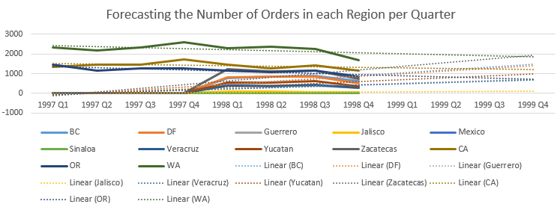
Analysis of Results
The graph shows the current number of orders (solid line) with the forecast for the next year (dotted line)
WA, the most successful region, seems to be going on the decline
BC seems to be going on a small rise, even if the number of orders fell during the last quarter

Slide 13
Analysis Of Results
A particular trend which was noticed across all the regions is that the number of orders dropped significantly during the final quarter of 1998
This could be due to a number of reasons, such as it being the holiday season and people may not want to spend too much during this period
There was a little bit of everything throughout the two years. There were regions which had a mix of highs and lows and others were orders dropped each quarter.
Orders were also negative on the three regions which had sales in both 1997 and 1998. When compared to the quarter of the previous year, only in two quarters (CA Q1 & WA Q2) were there increases in numbers of orders

Slide 14
Conclusion
Although not easy, forecasting can be a great tool for businesses to use
As more time passes by, forecasting can become more accurate, as the data at hand is much more vast and can help give a better indication of what is to come
It was disappointing that not all the regions had orders
For future research, it would be better to have a lot more data. A year (or two where applicable) is not enough to predict order numbers.
Forecasting could have been more accurate had more data been available

Slide 15
Any Questions?

